Slide 1


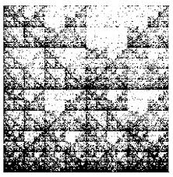
Reading DNA
as an Image Overcoming Linear Data Limits with FCGR and CV
Geonmin KIM 02416352
Jisoo PARK 02416525

Slide 2
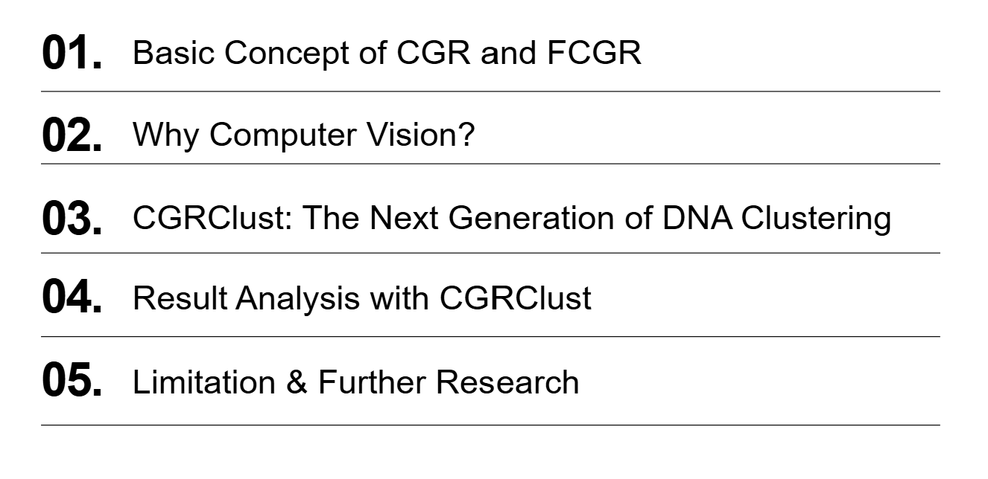
Contents

Slide 3
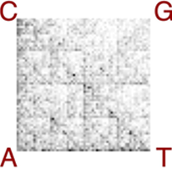
Overview
Traditional Approach
Alignment-free
A T G C A T C G
| | | | | | |
A T G C T T C G
• 1D String (A, C, G, T)
• Sequence Alignment
• Position-by-position Matching
• 2D Image
• Alignment-free
• Composition → Visual Data

Slide 4
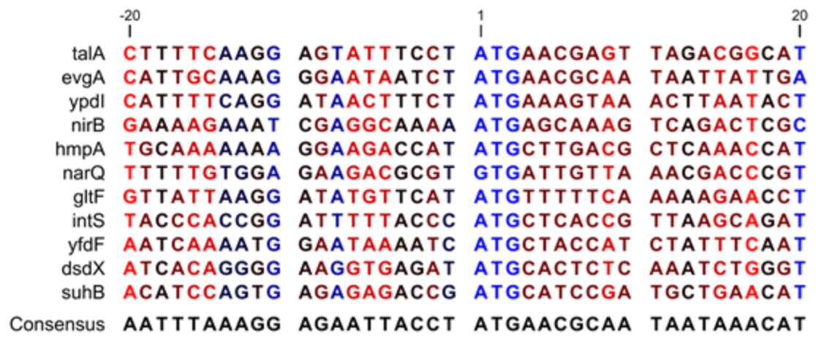
Why FCGR for Genome Sequencing?
Traditional DNA analysis: linear alignment
Substantial computation time
& Limitation of capturing global characteristics

Slide 5
Basic Concept of CGR and FCGR
ACTG
A
C
G
T

Slide 6
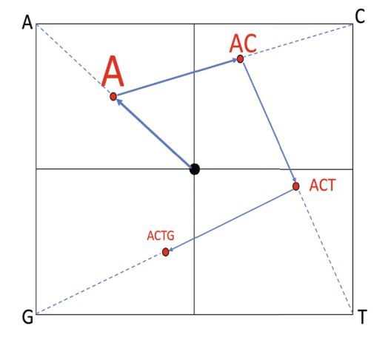
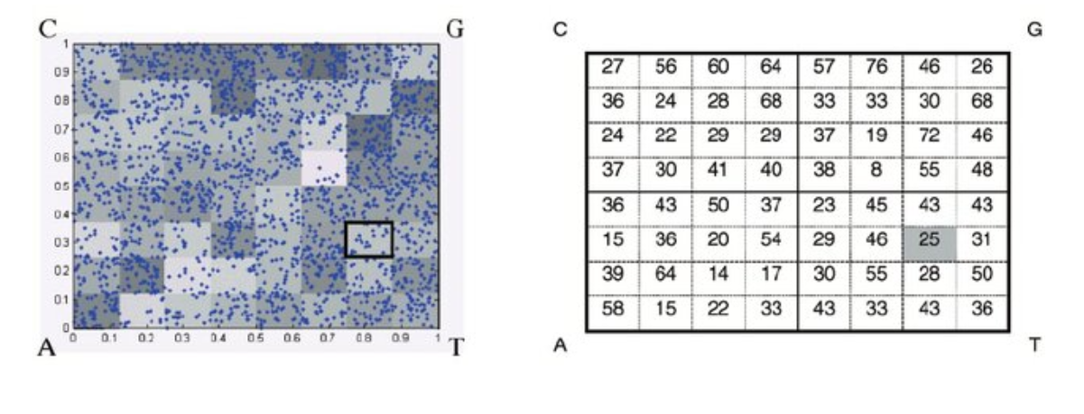
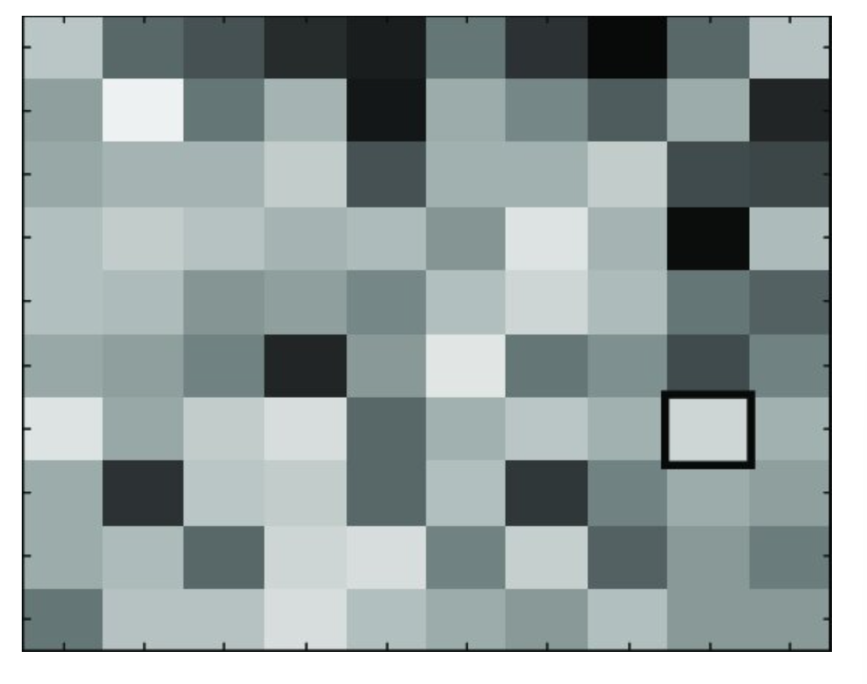
Basic Concept of CGR and FCGR

Slide 7
Why not Euclidean distance?
 | Euclidean Distance | DISSIM Distance
Calculation | Including flattening Subtraction, Squaring, Summation, Square root | Comparing brightness Comparing contrast Comparing structure
Properties | Do not consider structural relationship | Preserve the spatial relationships

Slide 8
CGRClust: The next generation of DNA clustering

Slide 9
Step1: Data Augmentation
[Weak Augmentation]
-Transition
…AACGTA…
…TCGAAC…
…GCGCAA…
⁝
…ACACTT…
…AACGTC…
…TCGTAC…
…GCGCAA…
⁝
…GCACTT…
[Input]
…AACGTA…
…TCGAAC…
…GCGCAA…
⁝
…ACACTT…
[Strong Augmentation]
-Transversion
…AACGTA…
…TCGAAC…
…GCGCAA…
⁝
…ACACTT…
…ACCATA…
…ACGAAC…
…GTGCGA…
⁝
…AGACAT…

Slide 10
Step2: Image Generation
[Weak Augmentation]
-Transition
…AACGTA…
…TCGAAC…
…GCGCAA…
⁝
…ACACTT…
…AACGTC…
…TCGTAC…
…GCGCAA…
⁝
…GCACTT…
[Input]
[FCGR Generation]
…AACGTA…
…TCGAAC…
…GCGCAA…
⁝
…ACACTT…
[Strong Augmentation]
-Transversion
…AACGTA…
…TCGAAC…
…GCGCAA…
⁝
…ACACTT…
…ACCATA…
…ACGAAC…
…GTGCGA…
⁝
…AGACAT…

Slide 11
Step2: Image Generation
[FCGR Generation]
- k = 6, (64×64)
- Intensity: Frequency of k-mer

Slide 12
Step 3: Clustering with CNN
FCGR
Image
CNN Backbone
(Conv + ReLU + MaxPool)
1×512
Embedding
[MLP]
ICH (Instance Head)
Row Space
CCH (Cluster Head)
Column Space

Slide 13
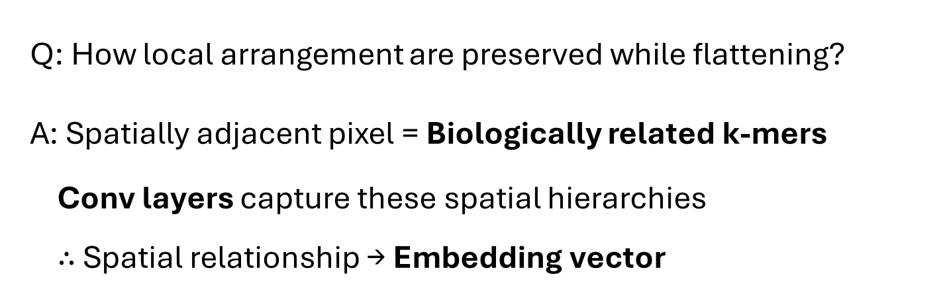
Step 3: Clustering with CNN
CNN Backbone
(Conv + ReLU + MaxPool)
Q: How local arrangement are preserved while flattening?
A: Spatially adjacent pixel = Biologically related k-mers
Conv layers capture these spatial hierarchies
$∴$ Spatial relationship → Embedding vector

Slide 14
Step 3: Clustering with CNN
FCGR
Image
CNN Backbone
(Conv + ReLU + MaxPool)
1×512
Embedding
[MLP]
ICH (Instance Head)
Row Space / 128-D
CCH (Cluster Head)
Column Space / N-D

Slide 15
Step 3: Clustering with CNN
1×512
Embedding
[MLP]
ICH (Instance Head)
Row Space / 128-D
CCH (Cluster Head)
Column Space / N-D

Slide 16
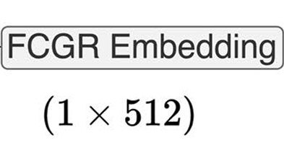
3. 2 Non-linear MLPs
Non-linear MLP of ICH
128 D Vector Space
Non-linear MLP of CCH
n Vector Space
n = Target Cluster Number

Slide 17
3. 3 Twin Contrastive Learning
Weakly
Augmented
: Maximize Similarity
ICH
: Minimize Similarity
: Row
Strongly Augmented
Target
Clusters’
: Maximize Similarity
CCH
: Minimize Similarity
: Column
Target Clusters

Slide 18
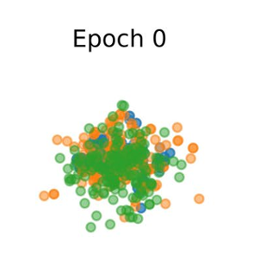
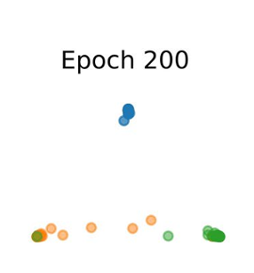
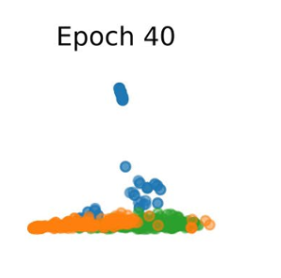
3. 3 Twin Contrastive Learning

Slide 19
3. 4 Majority Voting
5 Different Models
(Different Random Seeds)
Majority
Voting
Final Cluster
Assignment
→ To Reduce Initialization Sensitivity

Slide 20


Application
Targeted Treatment
& Vaccines
Highly Mutable Viruses
Viral Subtyping
Understanding Intraspecific Variations
Tracking Epidemiological Trends
e.g. HIV, Dengue Virus

Slide 21
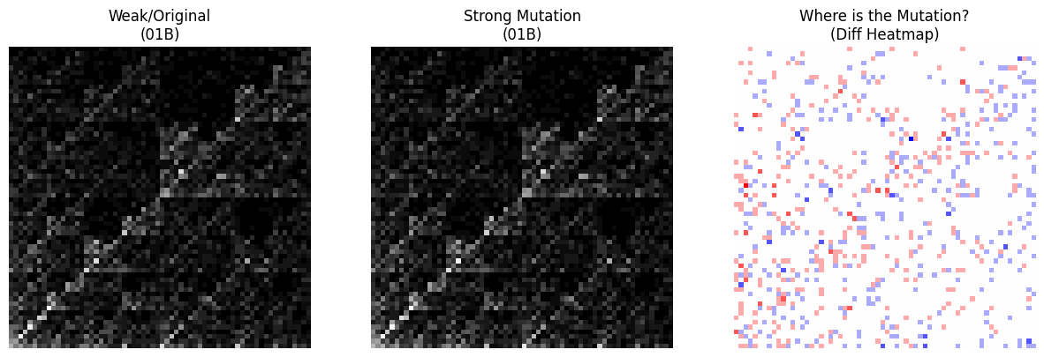
Result Analysis
[HIV]
Weak/Original
Strong Mutation
Visualization
Positive Diff: Newly Formed Patterns
Negative Diff: Lost Original Patterns

Slide 22
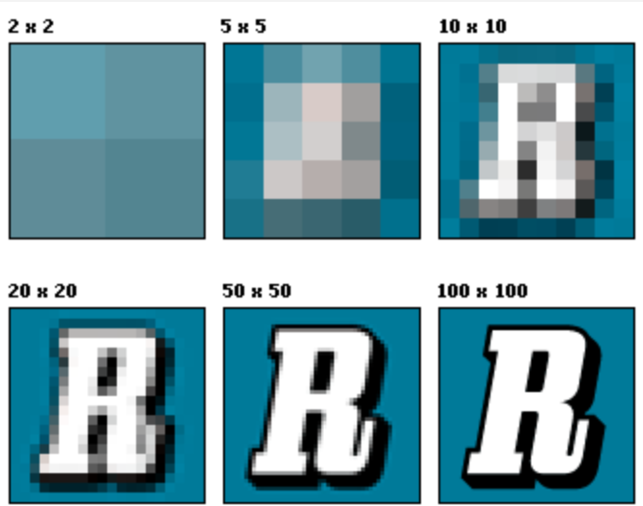
Limitations
Resolution Dilemma
: capturing complex mutations requires higher k-mer resolution.
Computational limitations and memory constraints

Slide 23
Further Research
Sequence-based Models
Image-based Approach
e.g. Mamba, Evo
Near-linear Scalability
e.g. FCGR
Intuitive Interpretability
Multimodal Genomic Analysis
Comprehensive Framework for Variant Tracking

Slide 24
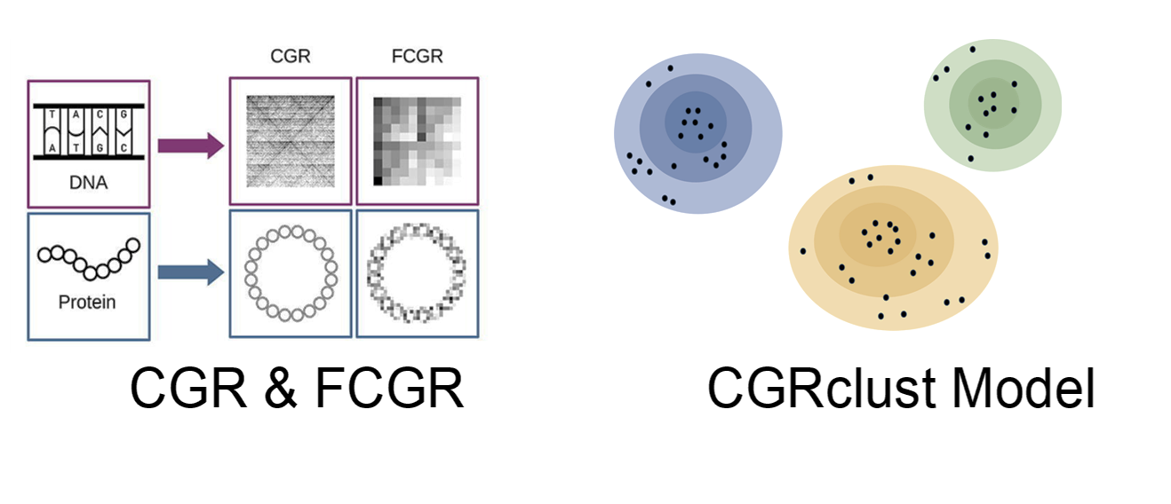
Q & A

Slide 25
References
Almeida, J. S., Carriço, J. A., Maretzek, A., Noble, P. A., & Fletcher, M. (2001). Analysis of genomic sequences by Chaos Game Representation. Bioinformatics (Oxford, England), 17(5), 429–437. https://doi.org/10.1093/bioinformatics/17.5.429
Alipour, F., Hill, K. A., & Kari, L. (2024). CGRclust: Chaos Game Representation for twin contrastive clustering of unlabelled DNA sequences. BMC Genomics, 25(1). https://doi.org/10.1186/s12864-024-11135-y
Joseph, J., & Sasikumar, R. (2006). Chaos game representation for comparison of whole genomes. BMC Bioinformatics, 7(1). https://doi.org/10.1186/1471-2105-7-243
Karamichalis, R., Kari, L., Konstantinidis, S., & Kopecki, S. (2015). An investigation into inter- and intragenomic variations of graphic genomic signatures. BMC Bioinformatics, 16(1). https://doi.org/10.1186/s12859-015-0655-4
Murad, T., Ali, S., & Patterson, M. (2023). A New Direction in Membranolytic Anticancer Peptides classification: Combining Spaced k-mers with Chaos Game Representation. Procedia Computer Science, 222, 666–675. https://doi.org/10.1016/j.procs.2023.08.204
Pixels and Image Resolution. (2013, September 11). Jamie Hickman . https://jamiehickmanvi.wordpress.com/unit-19/pixels-and-image-resolution/
Wang, T., Yu, Z.-G., & Li, J. (2024). CGRWDL: alignment-free phylogeny reconstruction method for viruses based on chaos game representation weighted by dynamical language model. Frontiers in Microbiology, 15. https://doi.org/10.3389/fmicb.2024.1339156
Zhang, Y., & Imoto, S. (2024). Genome analysis through image processing with deep learning models. Journal of Human Genetics, 69(10), 519–525. https://doi.org/10.1038/s10038-024-01275-0
(2026). Qiagenbioinformatics.com. https://resources.qiagenbioinformatics.com/manuals/clcgenomicsworkbench/700/BE_Sequence_logo.html

Slide 26
Thank You
Geonmin Kim Geonmin.Kim@ghent.ac.kr
Jisoo Park Jisoo.Park@ghent.ac.kr

Slide 27
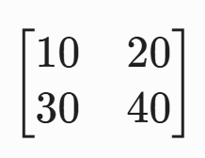
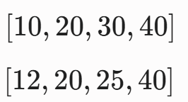
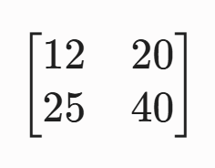
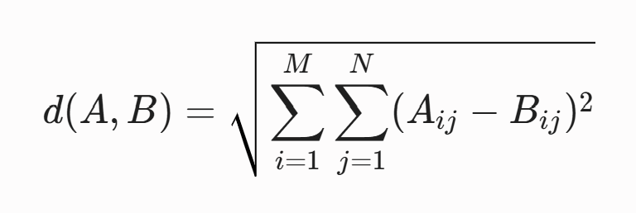

Appendix
Euclidean distance

Slide 28
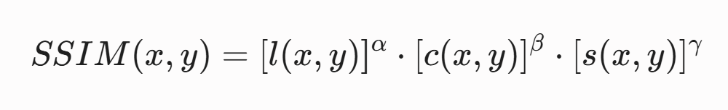
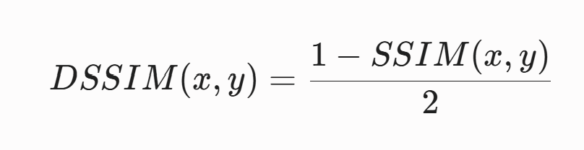
Appendix
DSSIM distance
L (luminance) : the average of brighteness
C (constrast) : the variance of pixel intensities
S (structure) : the spatial correlation of geometric patterns**
1: exactly same brightness, 0: opposite, -1: not exist
1: same variance of contrast, 0: opposite (monocolor or not)
1: same geometric pattern, 0: no correlation, -1: opposite pattern

Slide 29
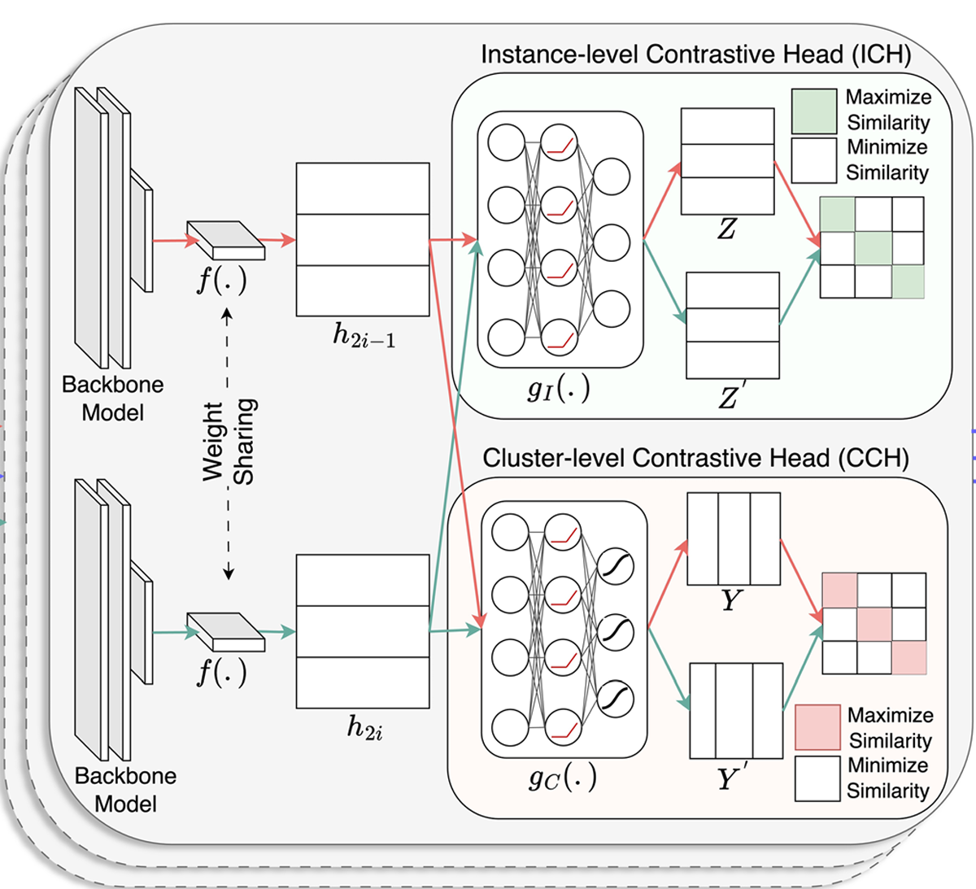
Appendix – Clustering Model

Slide 30

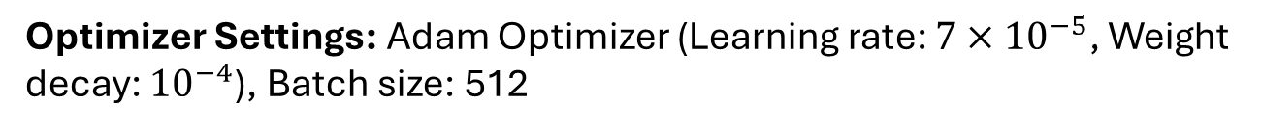
Appendix – TCL & Hyperparameter
Overall Loss Function: $L_{train}=αL_{ins}+(1−α)L_{clu}$
$L_{ins}$: Instance-level contrastive loss (via ICH)
$L_{clu}$ : Cluster-level contrastive loss (via CCH)
Balancing Parameter ($α$): $α=0.7$
(Empirically optimal value; range 0.5~0.8 yielded robust performance)
Temperature Parameters ($τ$ for InfoNCE loss):
$τ_{I}=0.1$: To distinguish subtle difference between individual data
$τ_{C}=1.0$ : To distinguish cluster
Dimensionality: ICH = 128 dimensions, CCH = Target cluster number
Optimizer Settings: Adam Optimizer (Learning rate: $7×{10}^{−5}$, Weight decay: ${10}^{−4}$), Batch size: 512

Slide 31
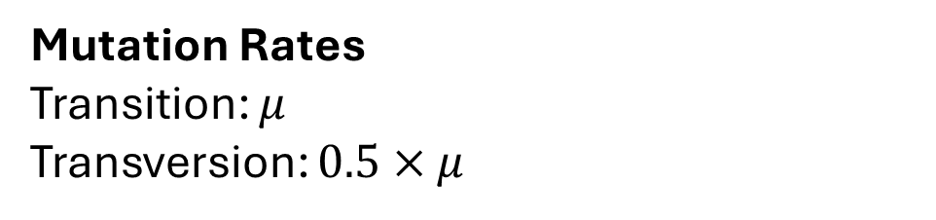
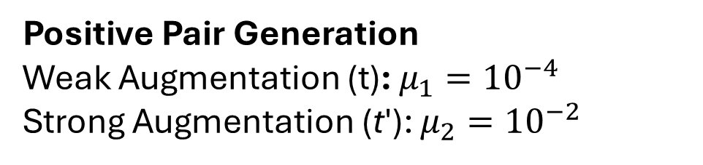
Appendix – Data Augmentation
Mutation Rates
Transition: $μ$
Transversion: $0.5×μ$
Positive Pair Generation
Weak Augmentation (t): $μ_{1}={10}^{−4}$
Strong Augmentation (t′): $μ_{2}={10}^{−2}$

Slide 32
Appendix – Model Performance & Evaluation
Evaluation Method
- Hungarian Algorithm
Accuracy
- Task: Viral Subtyping
Virus / Species | CGRclust (Ours) | DeLUCS | iDeLUCS
Dengue virus | 100.00% | - | 96.99%
Hepatitis C virus (HCV) | 85.79% | 84.63% | -
HIV-1 | 81.77% | 71.53% | 39.38%

Slide 33
Appendix – Why CNN?
CNN
- Strong Inductive Bias
- High Data Efficiency
- Translation Invariance
Vision Transformer
- Data-Hungry (1M+ images)
- Lacks Inductive Bias
- High Computational Cost
Transform Based
Deep
ResNet
- Risk of Overfitting
- Fine Texture Loss
- High Model Complexity
Residual Based

Slide 34
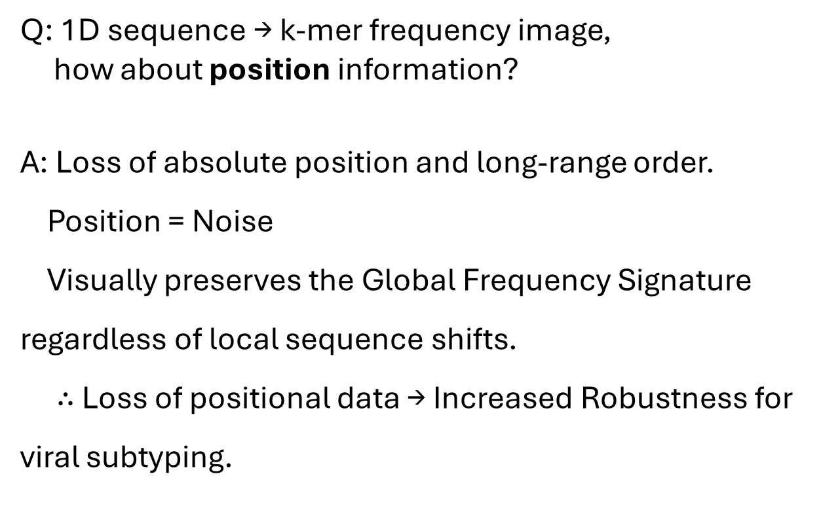
Appendix – Information Lost in FCGR Image
Q: 1D sequence → k-mer frequency image,
how about position information?
A: Loss of absolute position and long-range order.
Position = Noise
Visually preserves the Global Frequency Signature regardless of local sequence shifts.
$∴$Loss of positional data → Increased Robustness for viral subtyping.

Slide 35
Appendix – Inserted Result Visualization Code
# --- Comparsion between mutations and image restoring --- import os import matplotlib.pyplot as plt import numpy as np os.makedirs('mutation_pairs', exist_ok=True) print("Saving Augmented CGR mutation pairs with Diff map...") for i in range(3): # 3 blocks Graph fig, axes = plt.subplots(1, 3, figsize=(15, 5)) label_name = class_names[y_test[i]] img_weak = X_train[i][0] img_strong = X_train[i][1] # 1. Left Figure: Weak/Original axes[0].imshow(img_weak, cmap='gray') axes[0].set_title(f"Weak/Original\n({label_name})") axes[0].axis('off') # 2. Middle Figure: Strong Mutation axes[1].imshow(img_strong, cmap='gray') axes[1].set_title(f"Strong Mutation\n({label_name})") axes[1].axis('off') # 3. Right Figure: Diff Image (Strong - Weak) # Diff = 0; White, Diff increases +; Red, Diff decreases -; Blue diff_img = img_strong - img_weak axes[2].imshow(diff_img, cmap='bwr', vmin=-np.max(np.abs(diff_img)), vmax=np.max(np.abs(diff_img))) axes[2].set_title("Where is the Mutation?\n(Diff Heatmap)") axes[2].axis('off') plt.savefig(f"mutation_pairs/mutation_detail_{i}.png", bbox_inches='tight') plt.close()

Slide 36
Appendix – TCL
Source sequence (A)
→ Weak Augmentation (a’) & Strong Augmentation (A’)
[ICH]
Instance Identification
- Verify if a’ and A’ originated from the same source A
[CCH]
Cluster Alignment
Match cluster probability distributions of a’ and A’.
Normalize probabilities to
prevent trivial solutions (collapse).
- Sharpen boundaries between different viral subtypes.

